Slide 1
Executable and Linkable Format

Slide 2
Why ELF?
Foo.c
Foo1.c
Foo1.asm
Foo2.asm
Compiler
Foo1.o
Assambler
Foo.asm
Linker
Foo.exe
Foo.o
Foo2.o
Archiver
Foo.a

Slide 3
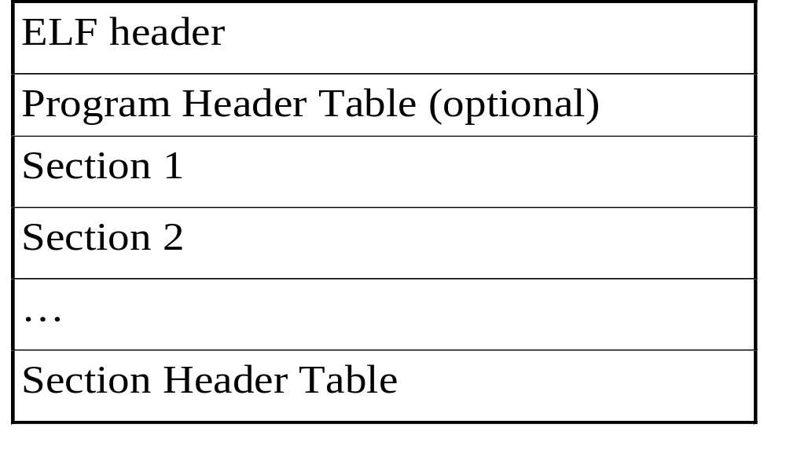
Object File Format

Slide 4
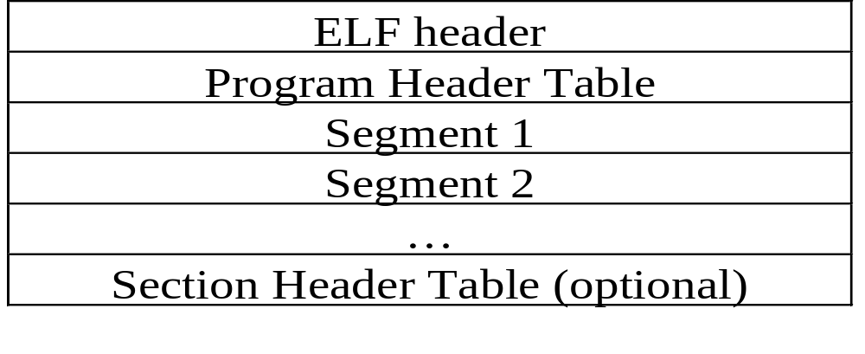
Executable File Format

Slide 5
ELF With Specific Sections
ELF Header
Section Header String Table (.shstrtab)
Executable Instruction Section (.text)
Initialized Data Section (.data)
Symbol Table (.symtab)
String Table (.strtab)
Relocation Information (.rela.text)
Section Header Table

Slide 6
Executable File in Memory
Executable ELF File
System Memory
Text:
P_type PT_LOAD
p_offset 0x100
p_vaddr 0x8048100
p_paddr unspecified
p_filesz 0x2be00
p_memsz 0x2be00
p_flags
p_align 0x1000
Address 0
ELF Header (e_entry)
Program Header Table
Header padding 0x100 bytes
Text segment
…
...
0x2be00 bytes
Data padding 0x100 bytes
Address 8048100
Other Information
Text Section Contents
(machine code)
Data:
P_type PT_LOAD
p_offset 0x2bf00
p_vaddr 0x8074f00
p_paddr unspecified
p_filesz 0x4e00
p_memsz 0x5e24
p_flags
p_align 0x1000
Text padding 0x100 bytes
Data segment
…
0x4e00 bytes
Uninitialized data 0x1024 zero bytes
page padding 0x2dc zero bytes
Data Section Contents
(program data)
Address 8074f00

Slide 7
ELF Header
Typedef struct {
Unsigned char E_ident[EI_NIDENT] Identification
Elf32_Half E_type File Type
Elf32_Half E_machine Machine
Elf32_Word E_version Version
Elf32_Addr E_entry Entry
Elf32_Off E_phoff Program Header Offset
Elf32_Off E_shoff Section Header Offset
Elf32_Word E_flags Flags
Elf32_Half E_ehsize ELF header Size
Elf32_Half E_phentsize Program Header Entry Size
Elf32_Half E_phnum Program Header Entry Number
Elf32_Half E_shentsize Section Header Entry Size
Elf32_Half E_shrum Section Header Entry Number
Elf32_Half E_shstrndx Section Index of String Table
} Elf32_Ehdr

Slide 8
ELF Header
Structure Relationships
ELF Header
e_phoff
e_shoff
e_ehsize
e_phnum
e_shnum
e_shstrndx
Dotted lines are used for
index values
Section header string table
Program Header number 1
…
Program Header number e_phnum
Solid lines are used for
file-offset values
Section header number 1
…
Section header number e_shnum

Slide 9
Program Header
Typedef struct {
Elf32_Word p_type Program Header Type Elf32_Off p_offset File Offset
Elf32_Addr p_vaddr Virtual Address
Elf32_Addr p_paddr Physical Address Elf32_Word p_filesz file image size
Elf32_Word p_memsz memory image size Elf32_Word p_flags segment flags
Elf32_Word p_align slignment
} Elf32_phdr
ELF Header
P_type = PT_LOAD
P_offset
p_vaddr
p_filesz
p_alignment
First byte
number p_filesz byte
Ladable
segment
Section Header Table

Slide 10
Section Header Table
Dash-dotted lines
are used for
relative offset
Typedef struct {
Elf32_Word Sh_name Name
Elf32_Word Sh_type Type
Elf32_Word Sh_flags Flags
Elf32_Addr Sh_addr Address
Elf32_Off Sh_offset File Offset
Elf32_Word Sh_size Size
Elf32_Word Sh_link Link
Elf32_Word Sh_info Info
Elf32_Word Sh_addralign Alignment
Elf32_Word Sh_entsize Entry Size
} Elf32_shdr;
Section number e_shstrndx
ELF Header
Section header string table
.rela.text section
.symtab section
.text section
Sh_name = .rela.text
sh_addr
sh_offset
sh_size
sh_link
sh_info
Section Header x
...
Section header number e_shnum

Slide 11
Symbol Table
Typedef struct {
Elf32_Word St_name Name
Elf32_Addr St_value Value
Elf32_Word St_size Size
Unsigned char St_info Binding / Type Info
Unsigned char St_other Other
Elf32_Half St_shndx Section index
} Elf32_sym
ELF Header
Section header string table
Number st_shndx section
st_name
st_value
st_size
st_shndx
Symbol Table
Entry x
...
Symbol Table Entry (sh_size/sh_entsize) of .symtab
Section header

Slide 12
Relocation Information
Typedef struct {
Elf32_Addr R_offset Offset / Virtual address
Elf32_Word R_info Symbol Table Index / Relocation Type
Flf32_Sword R_addend
} Elf32_sym
ELF Header
Section header string table
Number sh_inifo section
Number sh_link section
R_offset
r_info.symndx
r_info.reltype
r.addend
Relocation Information
Entry number x
...
Relocation info Entry (sh_size/sh_entsize) of .rel.xxx
.rel.xxx relocation
section header
Sh_link
sh_info
Section header

Slide 13
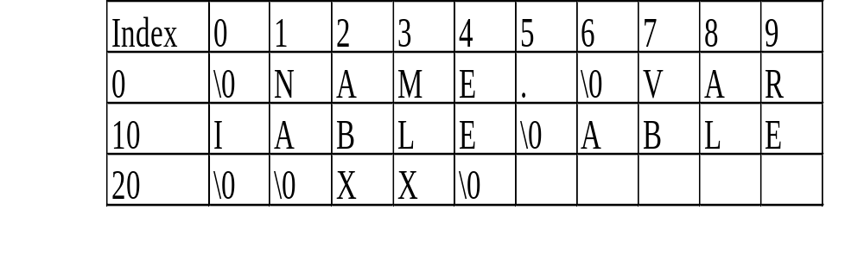
String Table

Slide 14
ELF Example
Source
.file 'exp2_1'
.global me
.text
Save %sp, -112, %sp
sethi %hi(0x10000), %o1
call me
ba number
ba it_addr
call it
it:
ret
.data
extra: .double 4
number : .double 5
it_addr: .double 4
.file 'exp2_2'
.global me
.text
me:
ret
.data
it: .double 4

Slide 15
Disassembly for Object File
disassembly for exp2_1.o
0: 9d e3 bf 90 save %sp, -112, %sp
4: 13 00 00 40 sethi %hi(0x10000), %o1
8: 40 00 00 00 call number
c: 10 80 00 00 ba 0xc
10: 10 80 00 00 ba it_addr
14: 40 00 00 01 call it
18: 81 c7 e0 08 ret
0: 4010 0000 0000 0000
8: 4014 0000 0000 0000
10: 4010 0000 0000 0000
disassembly for exp2_2.o
0: 81 c7 e0 08 ret
0: 4010 0000 0000 0000

Slide 16
Disassembly After Linking
disassembly for a.out
.text
102b0: 9d e3 bf 90 save %sp, -112, %sp
102b4: 13 00 00 40 sethi %hi(0x10000), %o1
102b8: 40 00 00 05 call me
102bc: 10 80 40 15 ba number
102c0: 10 80 40 16 ba it_addr
102c4: 40 00 00 01 call it
102c8: 81 c7 e0 08 ret
102cc: 81 c7 e0 08 ret
20308: 4010 0000 0000 0000
20310: 4014 0000 0000 0000
20318: 4010 0000 0000 0000
20320: 4010 0000 0000 0000

Slide 17
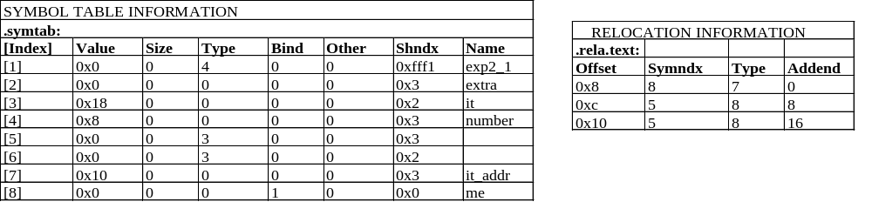
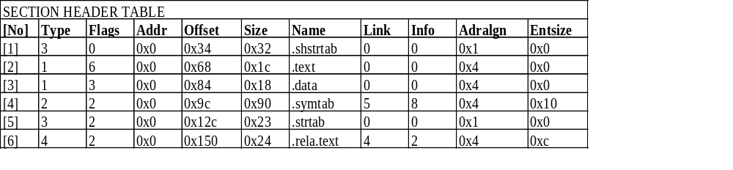
Exp2_1.o

Slide 18
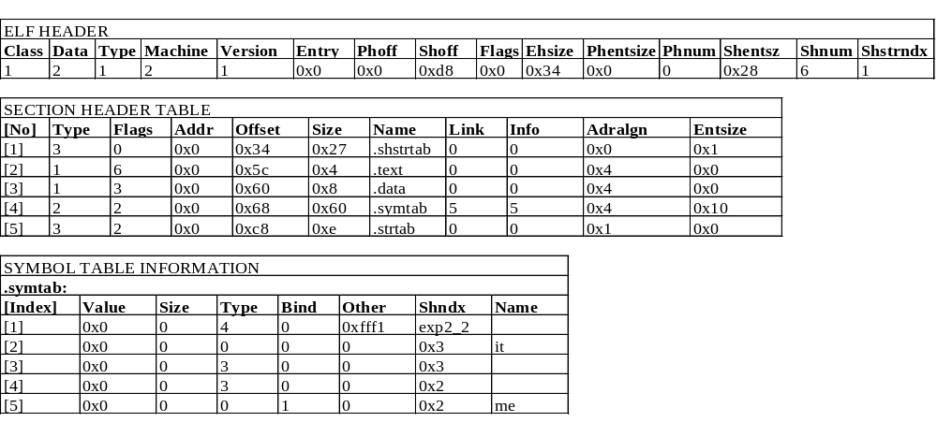
Exp2_2.o

Slide 19
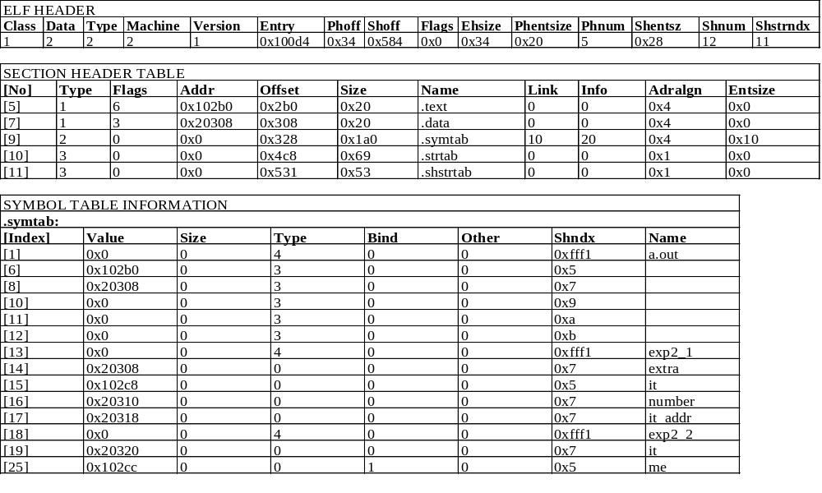
A.out

Slide 20
Linking Procedure

Slide 21
Terms
Linker - the application that combines multiple modules into an executable program
Loader - a kernel function that accepts an executable file and maps it into the virtual memory of the system
Downloader - the application that accepts a downloadable file and maps it into the memory of the ICE chip
Resolution - the act of associating a reference to a symbol with the definition of that symbol.
Relocation - A technique of supporting the concept of address-independent programs.

Slide 22
Combing Object Modules
File1.o
.text (file1.o)
output
.data (file1.o)
Symbol Table
.text (file1.o + file2.o + ...)
...
.data (file1.o + file2.o + ...)
Linker
Combined Symbol Table
File2.o
.text (file2.o)
….....
.data (file2.o)
Symbol Table
...

Slide 23
Linking to a shared objects
File1.o (Referencing object module)
.text section
main() {
other ();
};
Dynamically Linked Executable or Downloadable File
.text section
main() {
other ();
};
Symbol Table
Name: other
classs: external
value : 0
.loader section
IMPORT: other()
Linker
File2.o (shared object module)
.text section
other() {
};
Symbol Table
Name: other
classs: external
value : 0
.loader section
EXP: other()
Symbol Table
Name: other
classs: external
value :relocatable address

Slide 24
Resolving Symbols at
Download time
(Load time)
Main
Shared object
.text section
min {
other1();
other2();
};
.text section
other1() {}
other2() {}
.loader section
IMP: other1()
IMP: other2()
.loader section
EXP: other1()
EXP: other2()

Slide 25
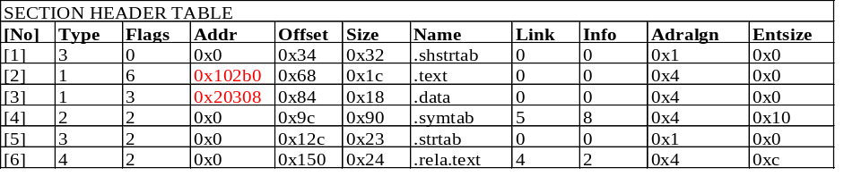
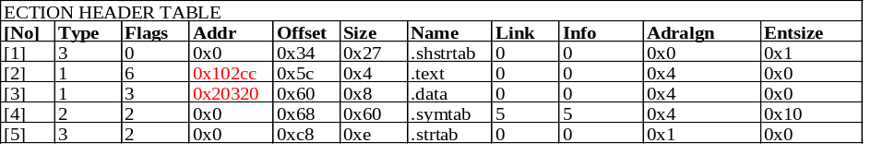
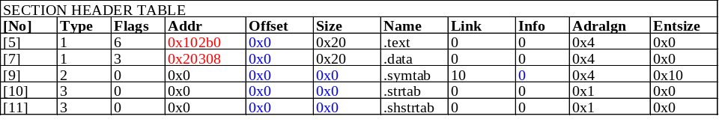
Relocation Process (Example) ...
Source
File 1
File 2
Destination

Slide 26
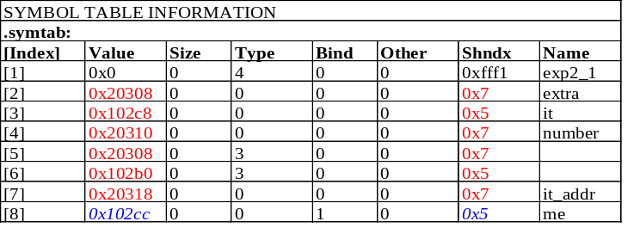
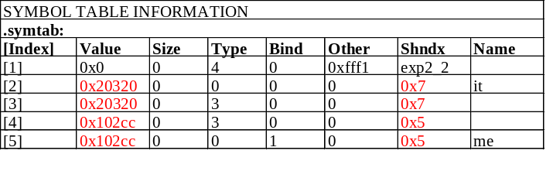
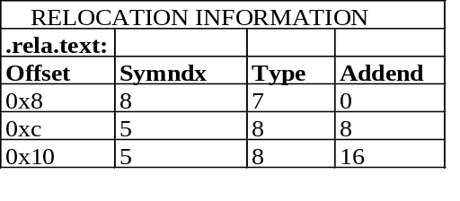
Relocation Process (Example)
File 1
File 2
Section
Alignment
(0x102cc + 0 - (0x8 + 0x102b0) / 0x4 = 0x0005
(0x20308 + 8 - (0xc + 0x102b0) / 0x4 = 0x4015
(0x20308 + 16 - (0x10 + 0x102b0) / 0x4 = 0x4016
Section
starting address

Slide 27
Design Architecture
OFD 1
OFD 2
OFD 3
Section Headers
Section Headers
Section Headers
Symbol Table
Symbol Table
Symbol Table
Control Center
Section List
Global Symbol Hasdh Table
Output Memory Map

